Slide 1
Declarative application management
Mixing the old with the new

Slide 2
bryanl
BOFH
bryanl

Slide 3
Lessons from Operations

Slide 4
Configuration Management for Operations

Slide 5
Imperative Configuration

Slide 7
---
name: Install nginx hosts: host.name.ip become: true
tasks:
name: Add epel-release repo yum:
name: epel-release
state: present
name: Install nginx yum:
name: nginx
state: present
name: Insert Index Page template:
src: index.html
dest: /usr/share/nginx/html/index.html
name: Start NGiNX service:
name: nginx
state: started

Slide 8
Configure repository
- name: Add epel-release repo yum:
name: epel-release state: present

Slide 9
Install nginx
- name: Install nginx yum:
name: nginx
state: present

Slide 10
Create HTML
- name: Insert Index Page template:
src: index.html
dest: /usr/share/nginx/html/index.html

Slide 11
Start Service
- name: Start NGiNX service:
name: nginx state: started

Slide 12
Configure repository
Install nginx
Start Service
Create HTML

Slide 13
Declarative Configuration

Slide 15
resource "docker_image" "nginx" { name = "nginx:1.11-alpine"
}
resource "docker_container" "nginx-server" { name = "nginx-server"
image = "${docker_image.nginx.latest}"
ports { internal = 80
}
volumes {
container_path = "/usr/share/nginx/html"
host_path read_only
= "/home/scrapbook/tutorial/www"
= true
}
}

Slide 16
Use Image
resource name = | "docker_image" "nginx" "nginx:1.11-alpine" | {
}

Slide 17
Configure Container
resource "docker_container" "nginx-server" { name = "nginx-server"
image = "${docker_image.nginx.latest}"
ports { internal = 80
}
volumes {
container_path = "/usr/share/nginx/html"
host_path read_only
= "/home/scrapbook/tutorial/www"
= true
}
}

Slide 18
Use Image
System State
Configure Container

Slide 19
Configuration Management for Ops: Lessons Learned
Ordering is hard
It’s easier to reason if you describe the end state
There is more than one way to do things

Slide 20
Declarative Applications (in Kubernetes)

Slide 21
- name: Create a k8s namespace k8s_raw:
name: testing
api_version: v1 kind: Namespace state: present

Slide 22
provider "kubernetes" {
config_context_auth_info | = | "ops"
config_context_cluster | = | "mycluster"
}
resource "kubernetes_namespace" "example" {
metadata {
name = "my-first-namespace"
}
}

Slide 23
{
"kind": "Namespace",
"apiVersion": "v1", "metadata": {
"name": "development",
"labels": {
"name": "development"
}
}
}

Slide 24
Operations tools can’t know about applications

Slide 25
Operations tools WON’T know about YOUR application

Slide 26
We need a better solution

Slide 27
Declarative or Imperative

Slide 28
“Go brush your teeth”

Slide 29
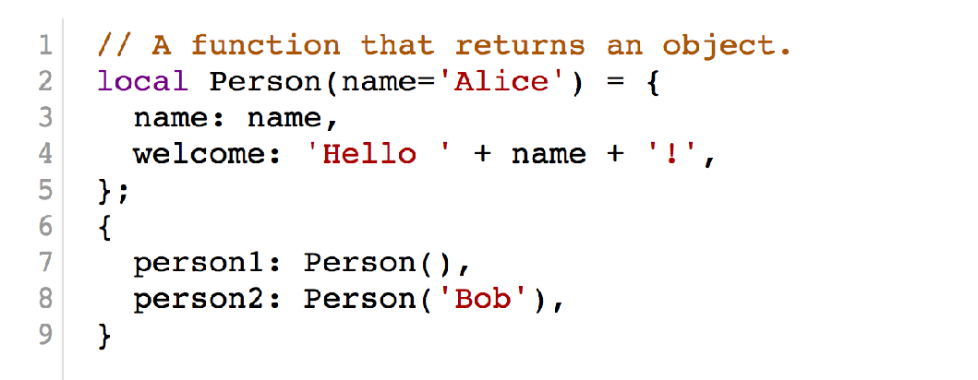
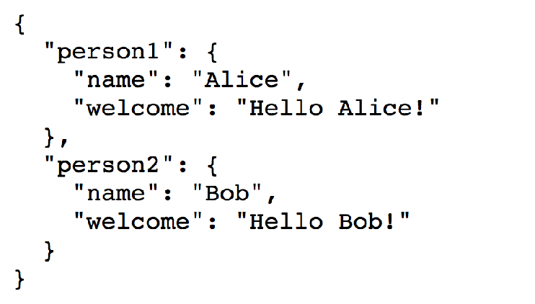
We need to move past templating

Slide 30
Managing complexity with composition

Slide 31
Divorcing your configurations from their values

Slide 32
Managing application complexity with ksonnet

Slide 33
Thinking about GitOps

Slide 34
GitOps
Change
Git Repository
Resource Changed
Update Process
Review/ Approval
YAML is for computers — ksonnet is for humans - @ksonnetio - @bryanl

Slide 35
Where can we go from here?

